Slide 1
FETAL HEALTH CLASSIFICATION

Slide 2
KEY AGENDA
INTRODUCTION TO FETAL HEALTH
DATASET ABOUT FETAL HEALTH
POSSIBLE SOLUTIONS
IMPLEMENTATION
RESULT

Slide 3
WHAT IS FETAL HEALTH?
Fetal conditions occur as your unborn baby develops in the womb. These conditions are also known as congenital, meaning a child is born with them. Some fetal conditions are genetic, or inherited from a parent.

Slide 4
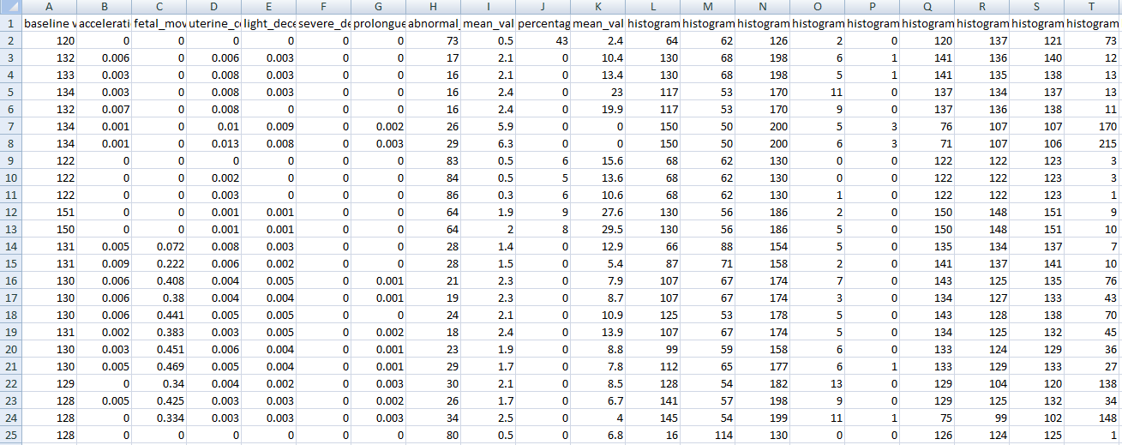
FETAL HEALTH DATASET

Slide 5
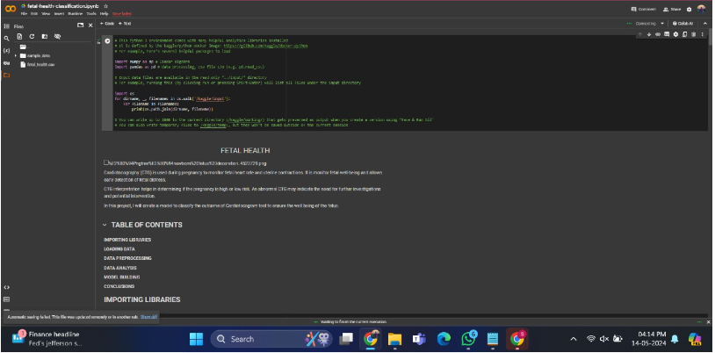
IMPLEMENTATION

Slide 6
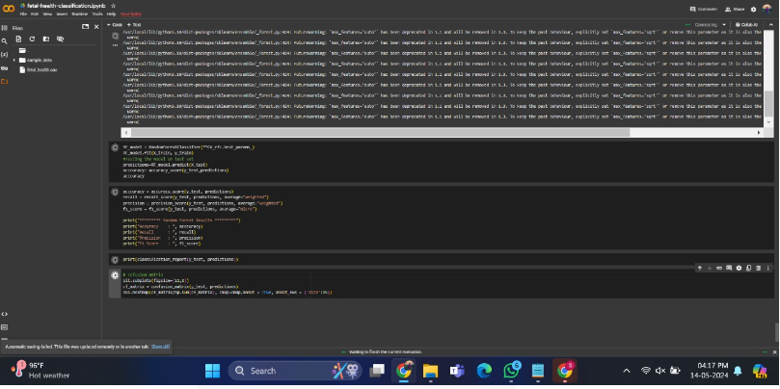
RESULTS

